Slide 1

Resolution Proof Method
IN PROPOSITIONAL LOGIC

Slide 2
Resolution Proof Method
It was proposed by J.A. Robinson in 1965 as a proof method for classical logics
Dedicated theorem provers based on resolution:
OTTER, PCPROOVE, AMPHION, Jape
It was easily adapted to nonstandard logics (modal, temporal, many-valued, non-monotonic).
Its basic aim is to check the consistency/inconsistency of a set of clauses.
It is based on syntactic considerations => syntactic method
The validity of a formula is proved by contradiction=>
=> refutation method

Slide 3
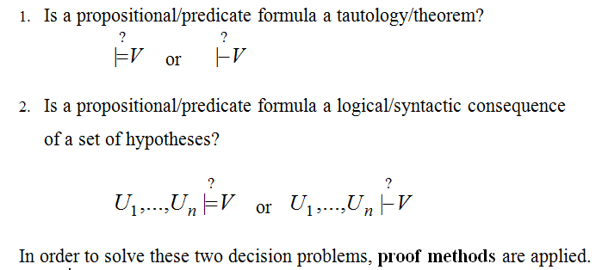
DECISION PROBLEMS IN PROPOSITIONAL/PREDICATE LOGIC

Slide 4
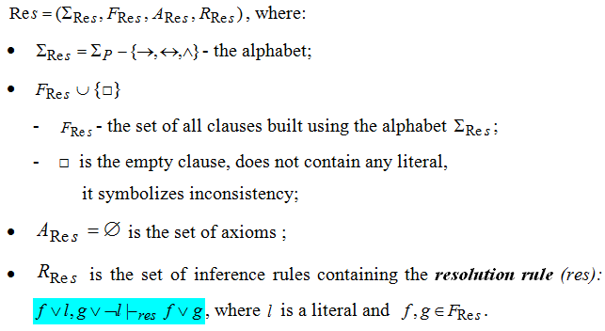
Resolution method - formal system for propositional logic -

Slide 5
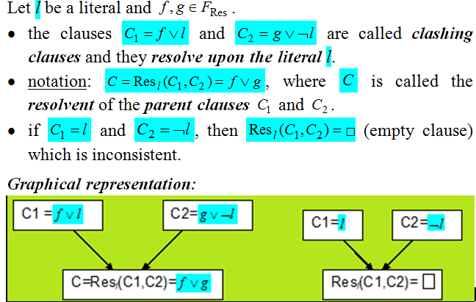
Definitions

Slide 6
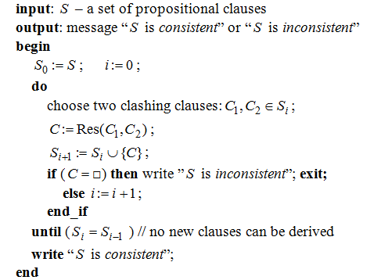
Algorithm: General_propositional_resolution

Slide 7
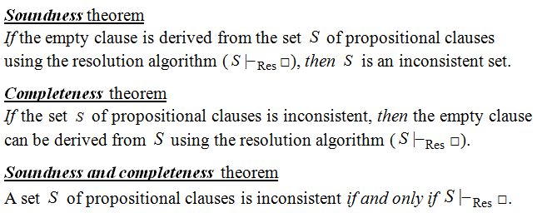
Theoretical Results

Slide 8
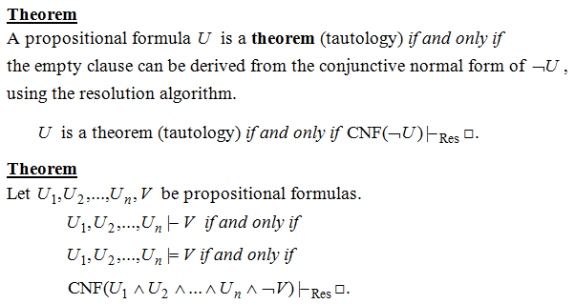
Resolution - a refutation Proof method

Slide 9
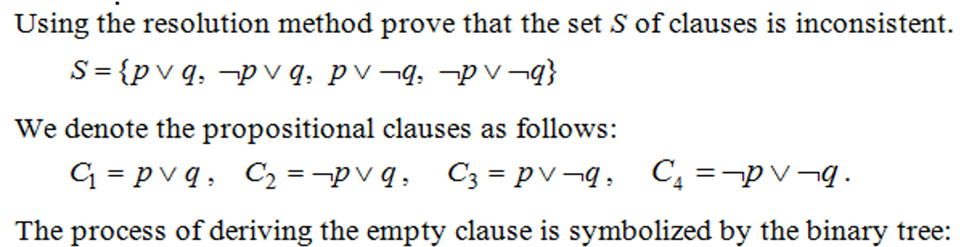
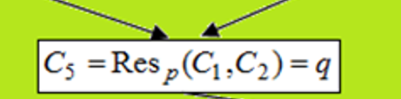
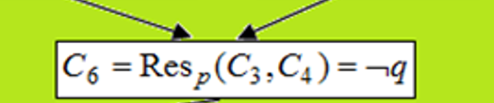

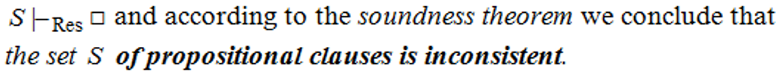
Example 1

Slide 10
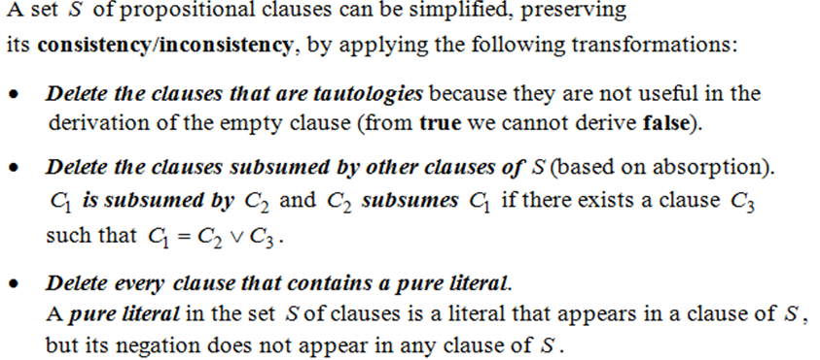
Theorem (based on Davis-Putman procedure)

Slide 11
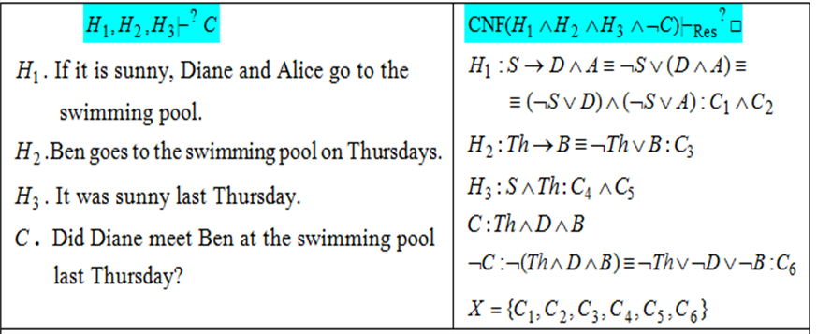
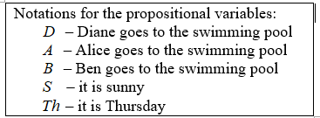
Example 2. Modeling reasoning

Slide 12
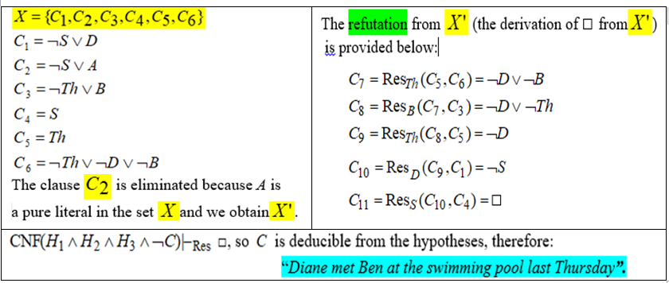
Example 2 – general Resolution(contd.)

Slide 13
Strategies and Refinements of Resolution
Strategies:
assure that all the possible clauses to be derived are generated
try to avoid the derivation of redundant and irrelevant clauses in order to obtain the empty clause.
level-saturation strategy, deletion strategy,
set-of-support strategy
Refinements
make the resolution process more efficient by imposing restrictions on the clashing clauses
lock resolution, linear resolution,
semantic resolution

Slide 14
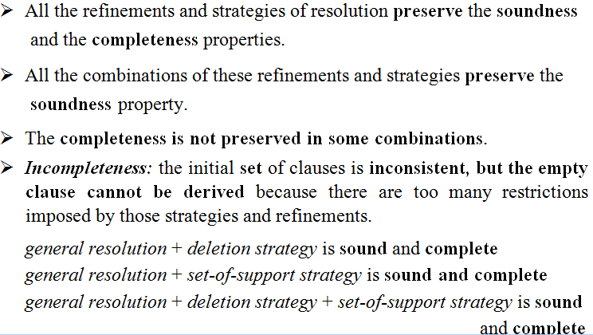
Remarks

Slide 15
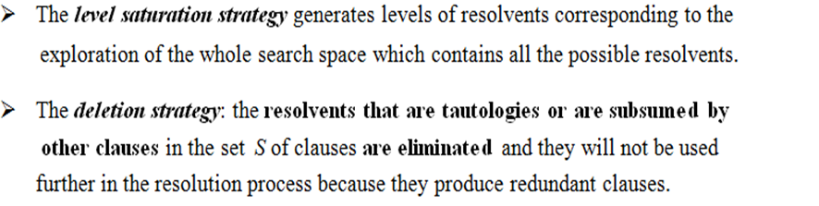
Strategies of Resolution

Slide 16
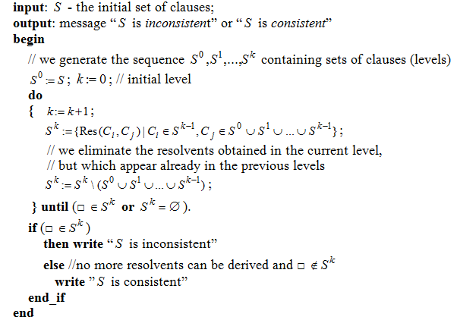
Algorithm: level-saturation-strategy

Slide 17
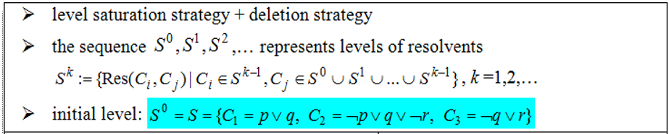
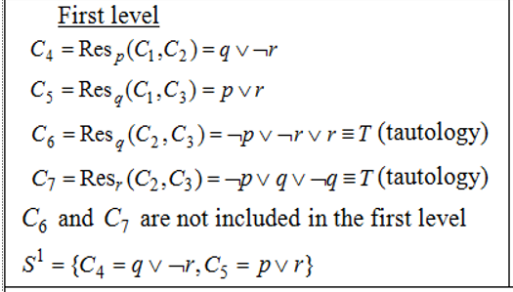
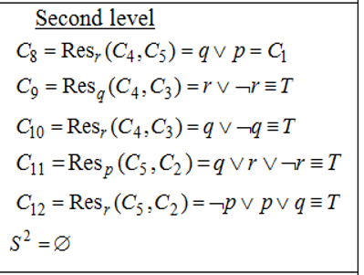

Example 3

Slide 18
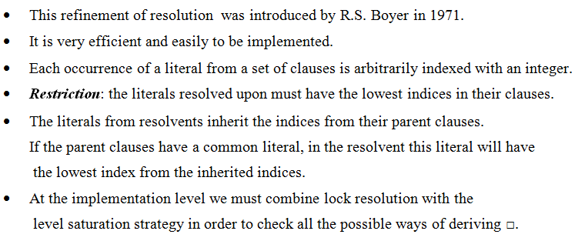
Lock Resolution

Slide 19
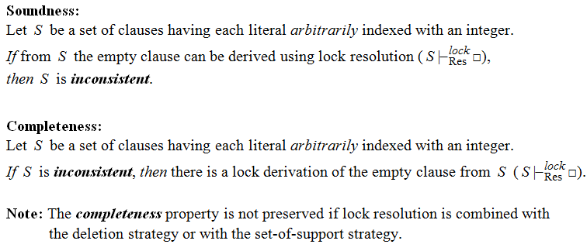
Theorems – Lock resolution

Slide 20
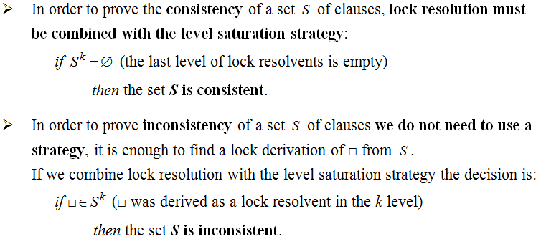
Remarks

Slide 21
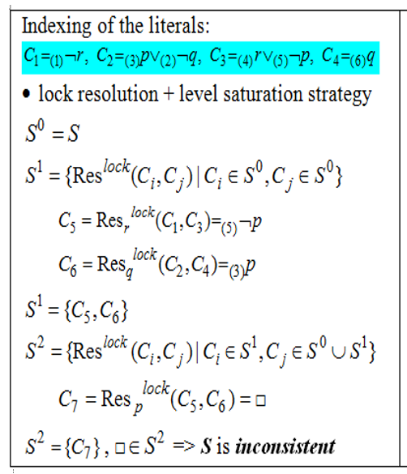
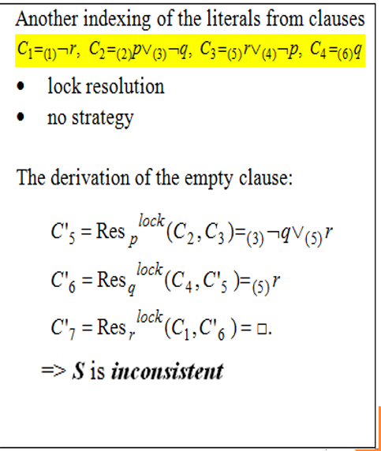
Example 4

Slide 22
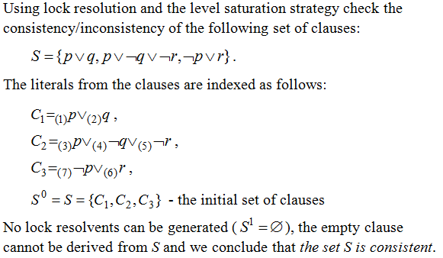
Example 5

Slide 23
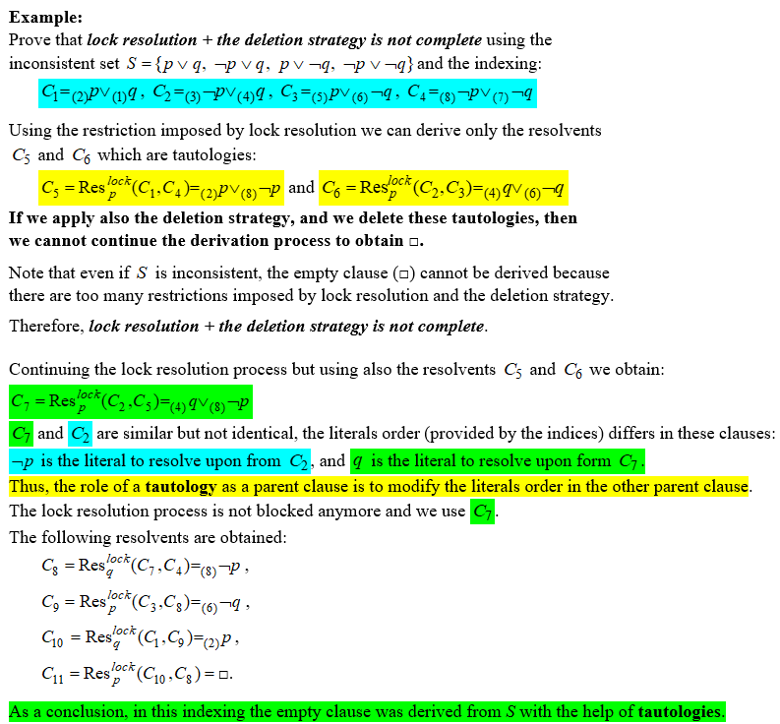

Slide 24
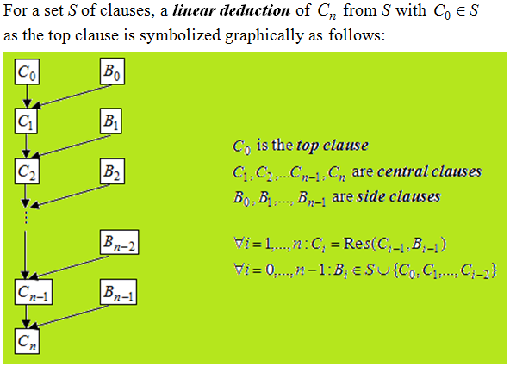
Linear Resolution (Loveland 1971)

Slide 25
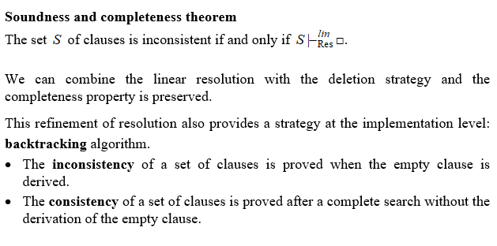
Theoretical results

Slide 26
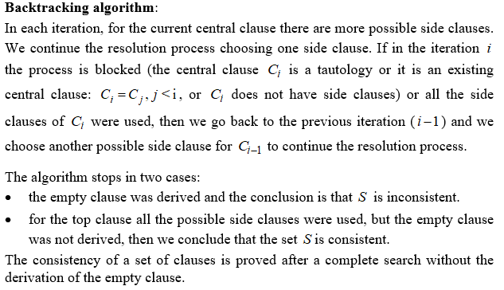

Slide 27
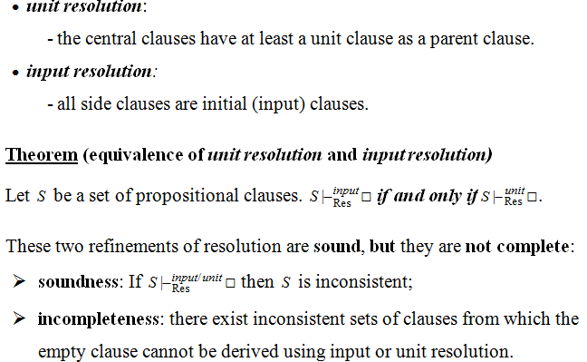
Special cases of linear resolution

Slide 28
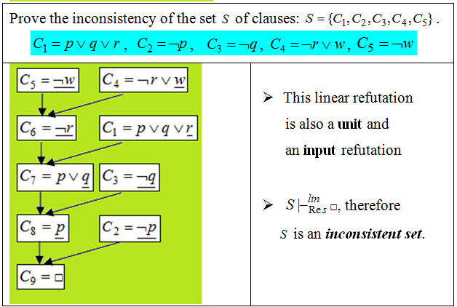
Example 6

Slide 29
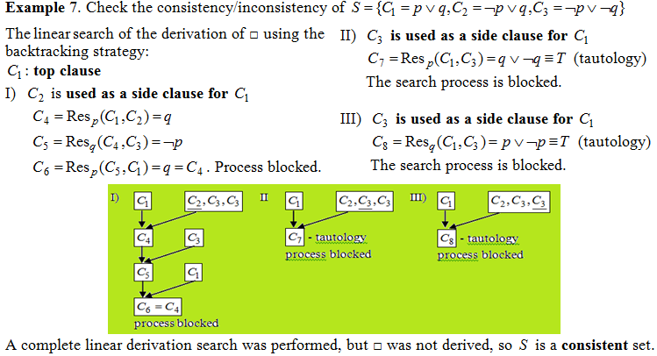

Slide 30
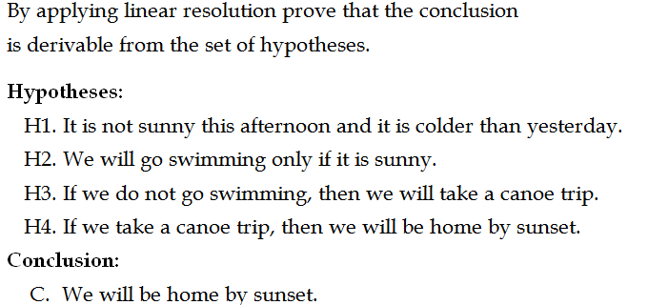
Example 8. Modeling reasoning

